Slide 1
TechBay
Submitted in the partial fulfillment for the award of the degree of
BACHELOR OF ENGINEERING
IN
Cloud Computing
Submitted by:
Trishank
18BCS4098
Under the Supervision of:
Dipra Mitra
Department of AIT-CSE
DISCOVER . LEARN . EMPOWER

Slide 2
Outline
Introduction to Project
Problem Formulation
Objectives of the work
Methodology used
AWS Hosting
Results and Outputs
Conclusion
Future Scope
References

Slide 3
Introduction to Project
At this age of modern technology where new gadgets and digital apps are developed or created each day, tech websites and blogs come in handy. Internet users would know these new technologies through reading blogs.
Problem Definition
Problem 1: Updating tech news regularly
News will be updated regularly with the help of API.
Problem 2: Hosting of the website
The website will be hosted on Aws without any cost.
Problem 3: Different feature to attract audience
Viewers will get an option to subscribe to our newsletter and get notifications so that they don't miss anything.

Slide 4
Project Overview
Our project Tech Bay is all about web development. It includes both front end and back end functionalities. From html css bootstrap to mongodb sql and api, this project has it all.
What this website basically does is it provides daily news related to technology. Whenever a fresh gadget comes this website updates dynamically and provides all the news related to that. The unique feature it has is that viewer can subscribe to our newsletter and he will get notifications time to time regarding latest news. Another feature worth mentioning is the use of AWS. As we are students of cloud so that's why we decided to include something from our field and what's better than AWS. We will host our website dynamically on AWS using it's features. This way we can make our website a little different from others without compromising it's features

Slide 5
Problem Formulation
Too many textures and colors.-You are trying to add interest, but you just add clutter. Limit colors and fonts. Maintain a thematic color scheme. For professional sites, try to limit the variety of fonts to three or fewer.
Design for the wrong reasons-Always begin by identifying your target audience and customizing design and content. You may want your site to look "modern" or like another site you've seen, but if you haven't checked in with what your audience needs and wants, you can fail miserably.
Your site isn't optimized for mobile-You shouldn't need to be reminded of this, but numbers don't lie. Mobile is overtaking desktop. It's increasingly likely that your visitors see your site on a tiny screen. If they have to pinch and stretch to read, they'll find a better source of information. Be sure to test your site on smartphone and tablet.
Balancing automated testing- Test too much, you spend time building tests. Test too little, stuff will break in production.
.

Slide 6
CONTD….
Keeping a good balance between long term and short term design desitions- Too short, and the code will break apart upon your next change. Too long, your team wont be agile enough.
Communicate key design concepts-best practices and library usage throughout the team. With too little freedom, people will get bored and do a bad job. With too much freedom people will create clusters of good code that doesn’t work well together. I don’t want a cathedral nor a bazaar.

Slide 7
Objectives
- Working on this wed site and doing a research over the new topics we have learned
the following things -
1. Designing UI using CS and Bootstrap.
2. Programming in Javascript for proper functionality.
3. Usage of API or databases for content.
4. Connectivity API's with our website.
5. Handling API and managing them.
6. Learning the other new technology and tech news for our website.

Slide 8
Methodology used
In this website, we have used the following –
1 HTML provides the basic structure of sites, which is enhanced and modified by other technologies like CSS and JavaScript. CSS is used to control presentation, formatting, and layout. JavaScript is used to control the behavior of different elements
2. The primary use of Express is to provide server-side logic for web
3. Node.js used for traditional web sites and back-end API services
4. All communication done via REST API .
5. MongoDB Database for database management.

Slide 9
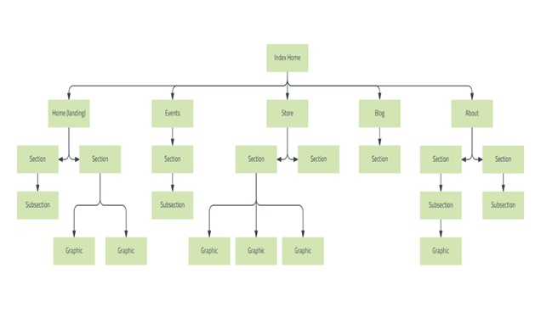
BASIC FLOWCHART

Slide 10

AWS Hosting
1. Make a bucket by the name of “techbay”
$ aws s3 mb s3://techbay
2. Upload your content to that bucket i.e file like server.js,package.js etc
3. Give your bucket public access.
4. Enable Bucket versioning so in future if you want changes in your websites so it keeps multiple variants of an object in the same bucket.

Slide 11
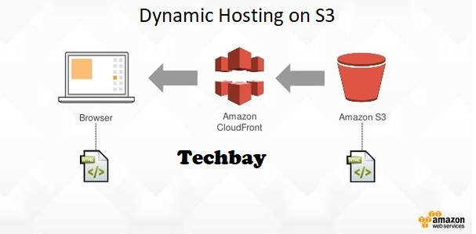
Dynamic hosting

Slide 12
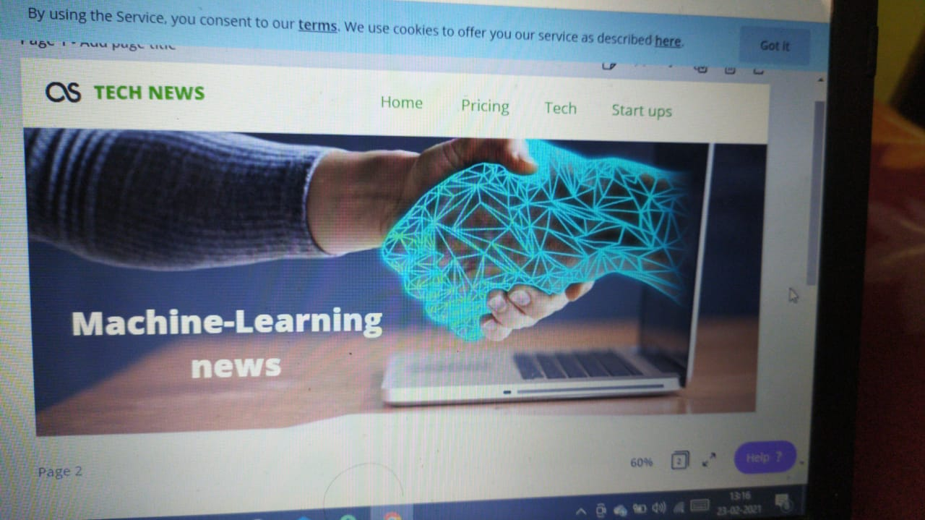
Results and Outputs HOW IT WORKS…….. Every day of a news cycle seems to bring a new revelation, a new controversy, or a new talking point. During these blink-and-you’ll-miss-it months, those who are committed to staying informed about the new tech often rely on tech news sites that are always being updated with the latest breaking news. Reuters, the wire service that acts as the news source for most news outlets, is one of the best options to choose from. We are making a website that will keep you updated with latest tech news using the latest and most suited tools.

Slide 13
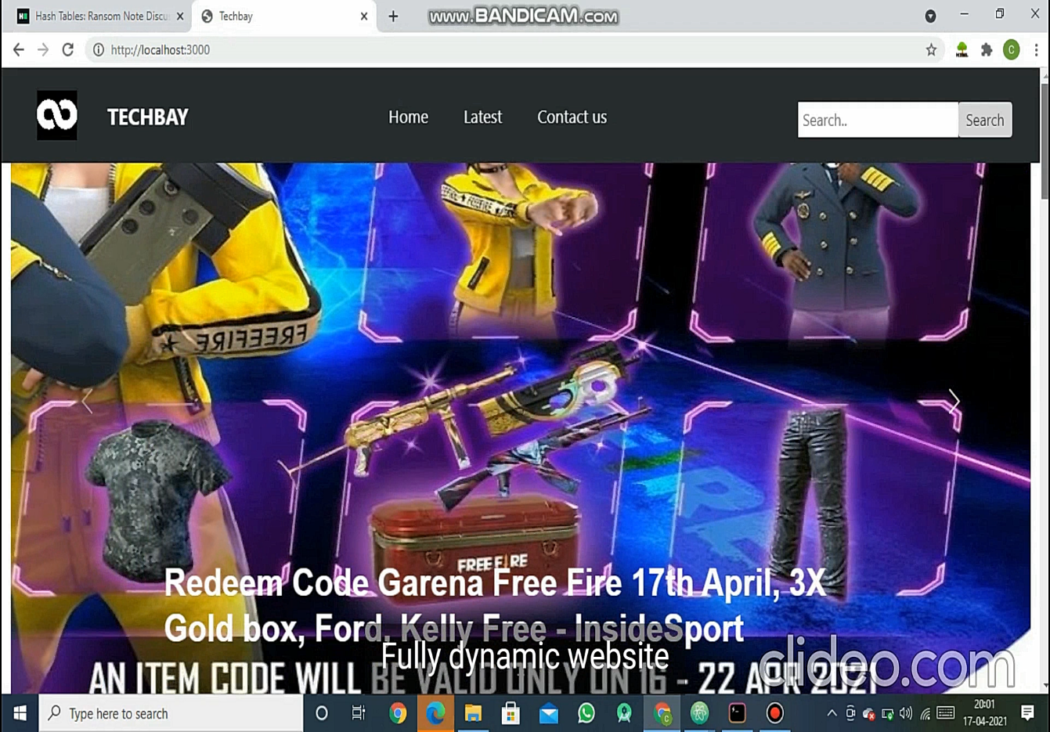
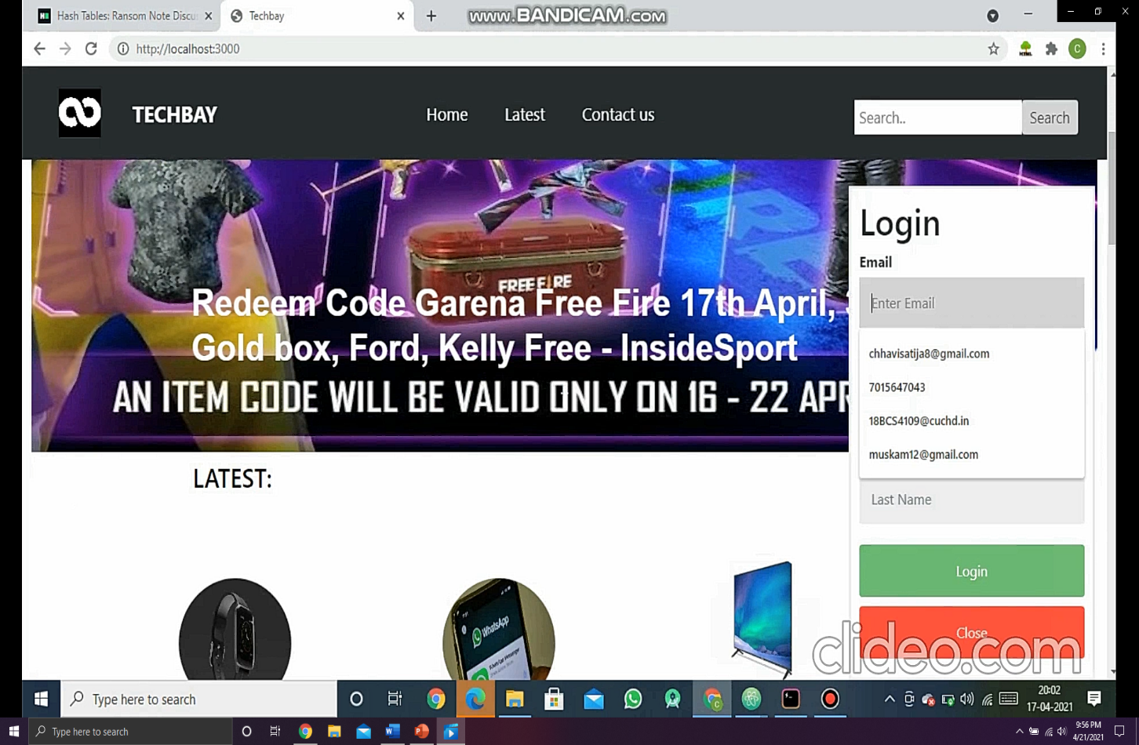
Login Option..

Slide 14
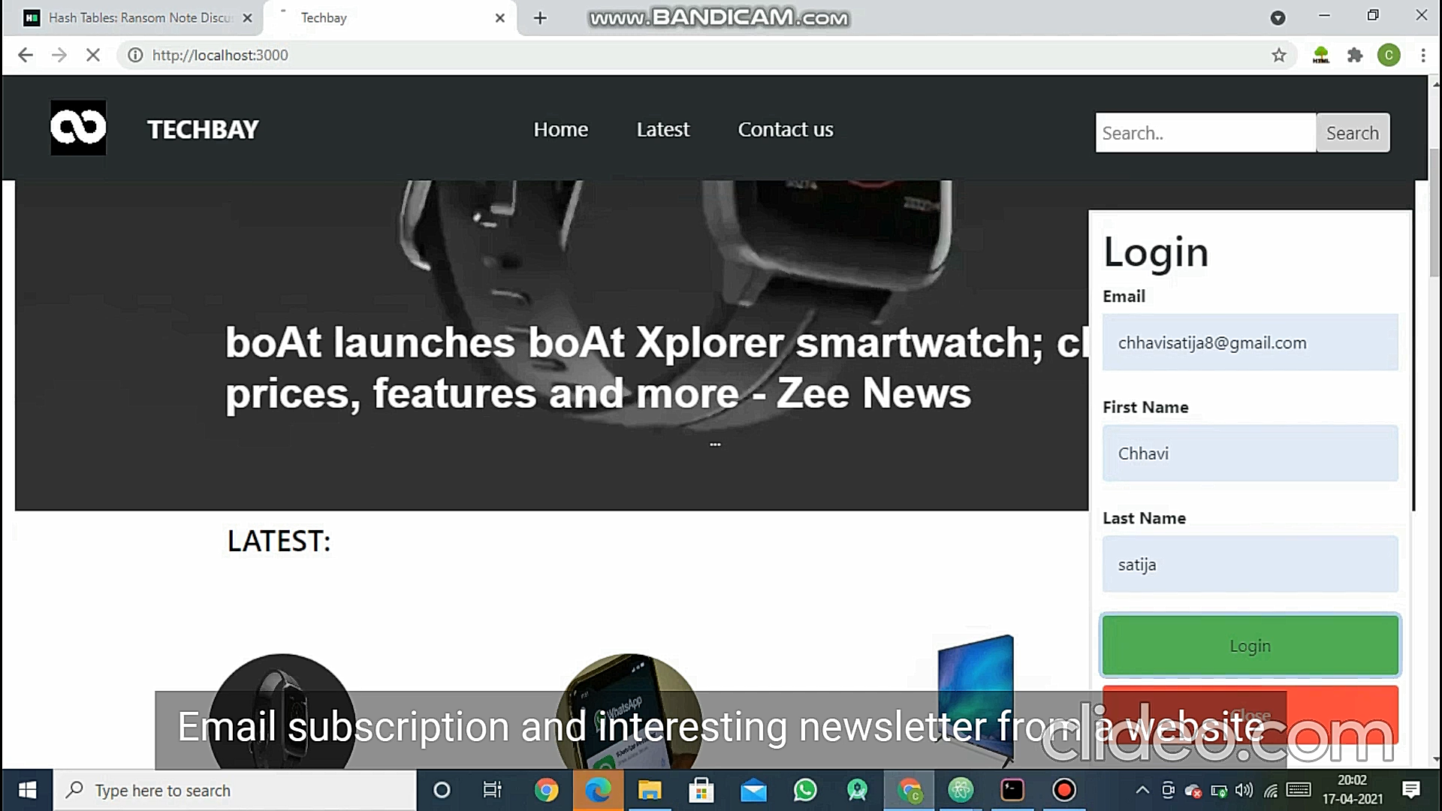
Contd…

Slide 15
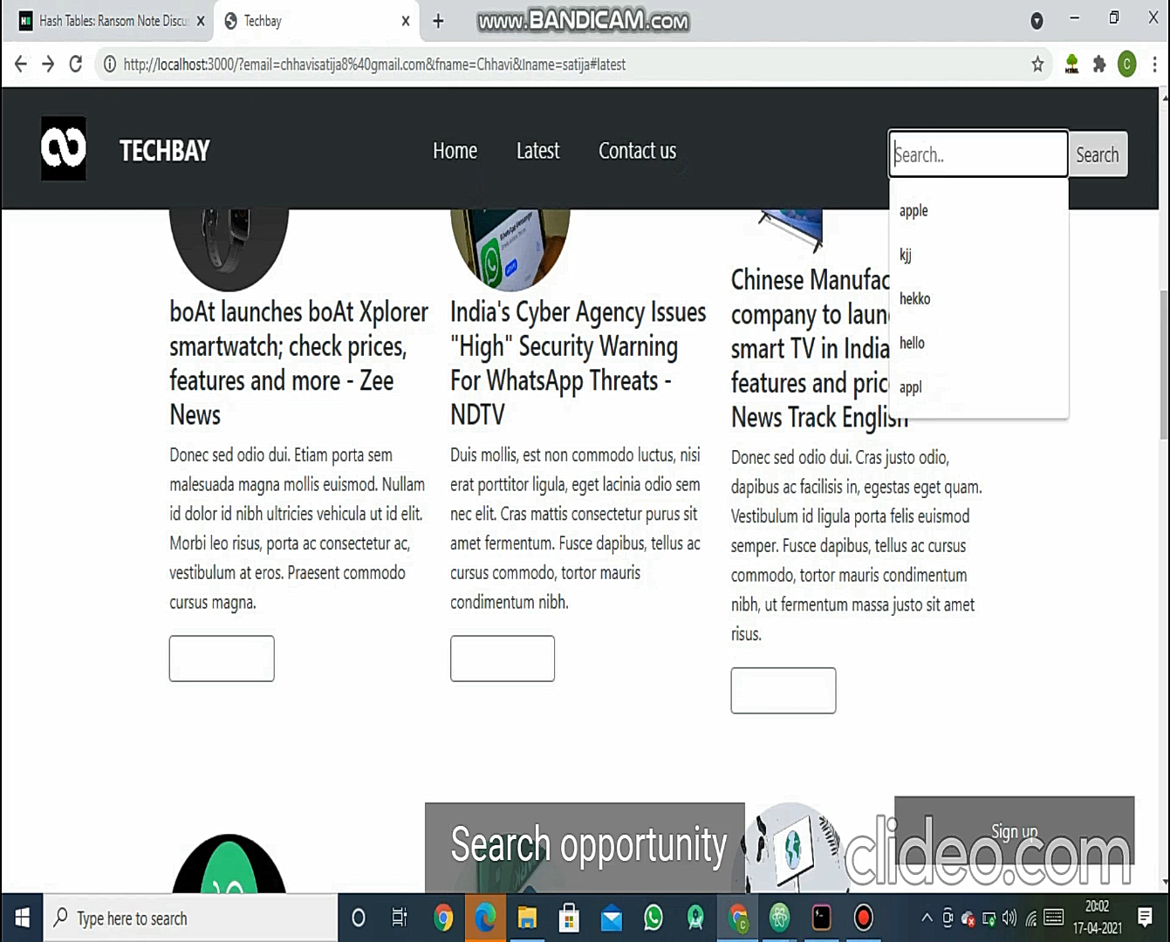
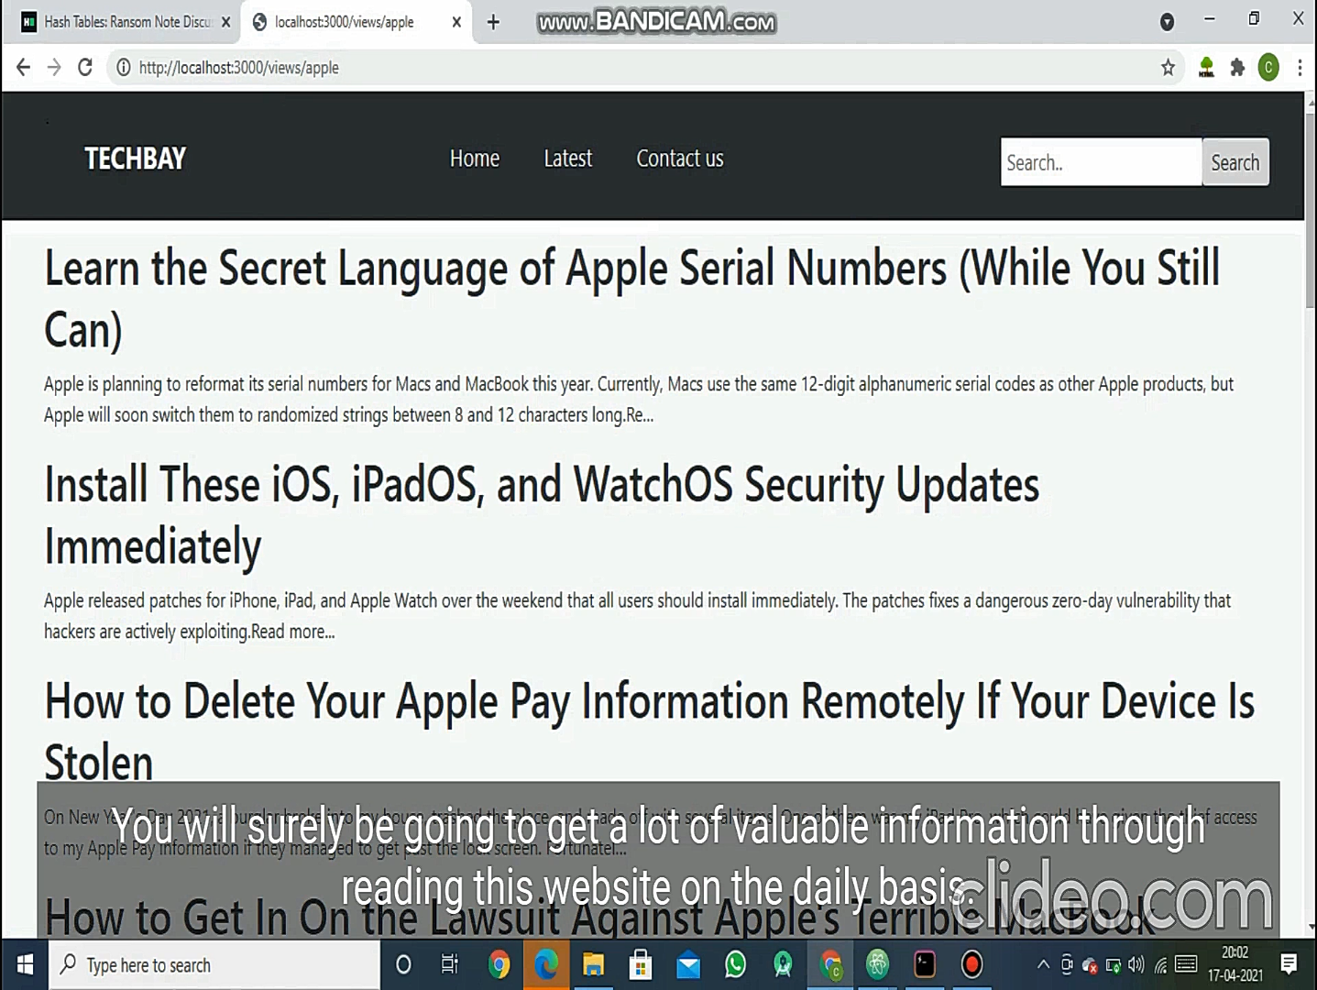
How search bar works…

Slide 16
Conclusion
A lot of project has carried out on online news system.At the present time,online news website are available. But most of website is static and traditional. There is no feature that can make people
Awareness. That is why we have done this project. Our project it has many many features that can make people aware .By using this website one can get more and more information regarding the tech news that helps people in their daily life.
In this project we have develop an tech news website.It is adynamic system.It can be maintained and changed easily as it is based on database. It contain web pages that are generated in real time.These
Pages include EJS(Embedded JavaScript). It is fully secured from unauthorized access.In a word it can say that our tech news website is completely dynamic website.
To create the software, we have all possible types of basic codes used for principle design based on mainly HTML CSS Javascript .Here we have used incremental model to create the software.We have collected all kinds of information related to this software from the customer. Actually,it is one kin d of customized software products.

Slide 17
Future Scope
Web Designing has become the primary source for web developers and websites to place their foot in the digital world. Almost every website requires a proper Web Designing candidate which allows it to stand tall for a proper result. Thus, choosing Web Designing as a career option will indeed give great results to any candidate. The Future scope of Web Designing Course in India is brightly increasing it has become a major development in India. But to get the best Web Designing career options, you need to undergo a proper Web Designing Course in India from a reliable institution. This allows you to learn all about the subjects, the languages involved with it and the creative skills.

Slide 18
References
[1]. P. Priya1, V. Saranya2, S. Shabana3, Kavitha Subramani4, “The Optimization of Website develpoment and Management System by Technopedia”. Department of Computer Science and Engineering, Panimalar Engineering College, Chennai, India, Volume 3, Special Issue 1, February 2014
[2]. Tushar Pandit, Satish Niloor and A.S. Shinde,”MAKING A DYNAMIC WEBSITE”. Dept. of I.T Sinhgad Academy of Engineering, Pune, India. Year 2015.
[3]. Narendra Gupta1, Ramakant Gawande2 and Nikhil Thengadi3, “MBB: Application”. Final Year, CSE Dept., JDIET, Yavatmal, India.VOLUME-2, SPECIAL ISSUE-1, MARCH-2015.
[4]. Vikas Kulshreshtha, Dr. Sharad Maheshwari, “DATABASE Management”. International Journal of Engineering Research and Applications (IJERA) ISSN: 2248-9622 Vol. 1, Issue 2, pp.260-263.
[5]. Sultan Turhan.
[6]. T.Hilda Jenipha*1 R.Backiyalakshmi*2, “WEBSITE DEVELOPEMENT in Cloud Computing”. Department of Computer Science and Engineering, PRIST University, Puducherry, India. e-ISSN : 2320-0847 p-ISSN : 2320-0936 Volume-03, Issue02, pp-105-108. Year 2014

